Slide 1
NORTON’S THEOREM
Dr. T.YUVAPRIYA
ASSISTANT PROFESSOR
SELECT

Slide 2
INTRODUCTION
Fig. 3.155 (i) shows a network enclosed in a box with two terminals A and B brought out.
The network in the box may contain any number of resistors and e.m.f. sources connected in any manner.
But according to Norton, the entire circuit behind AB can be replaced by a current source IN in parallel with a resistance RN as shown in Fig. 3.155 (ii).
The resistance RN is the same as Thevenin resistance RTh. The value of IN is determined as mentioned in Norton’s theorem.
Once Norton’s equivalent circuit is determined [See Fig. 3.155 (ii)], then current in any load RL connected across AB can be readily obtained

Slide 3
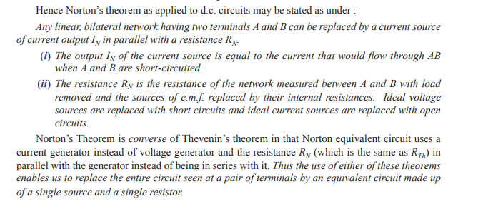
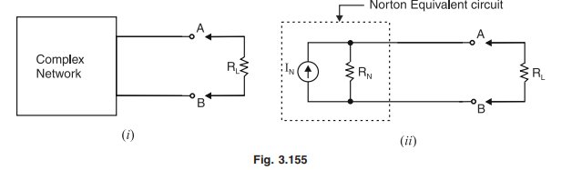

Slide 4
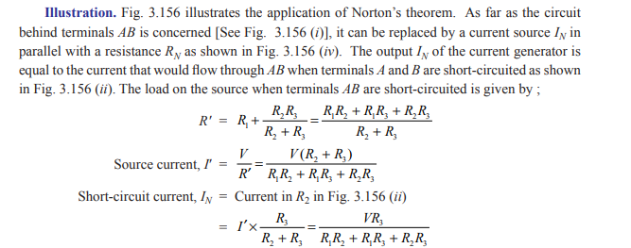

Slide 5
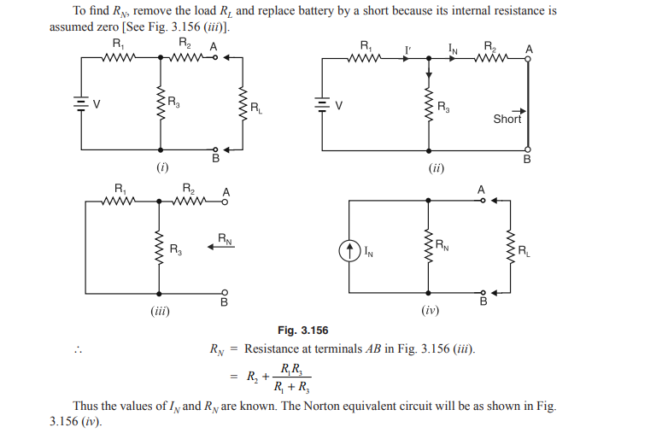

Slide 6
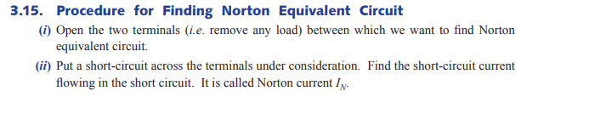
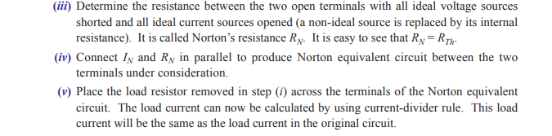

Slide 7
Another method of analyzing the circuit is given by Norton’s theorem, which states that any two terminal linear network with current sources, voltage sources and resistances can be replaced by an equivalent circuit consisting of a current source in parallel with a resistance.
The value of the current source is the short circuit current between the two terminals of the network and the resistance is the equivalent resistance measured between the terminals of the network with all the energy sources are replaced by their internal resistance.

Slide 8
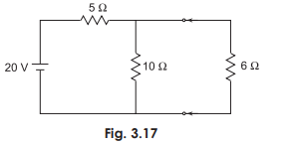
According to Norton’s theorem, an equivalent circuit can be found to replace the circuit in Fig. 3.17

Slide 9
In the circuit if the load resistance 6 W is connected to Norton’s equivalent circuit, it will have the same current through it and the same voltage across its terminals as it experiences in the original circuit.
To verify this, let us find the current passing through the 6 W resistor due to the original circuit.

Slide 10
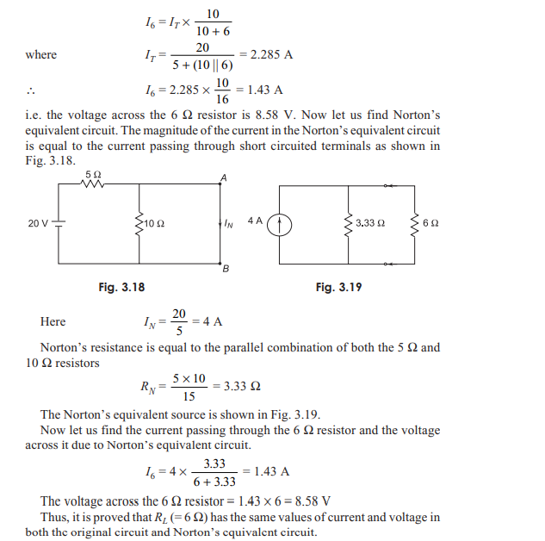

Slide 11
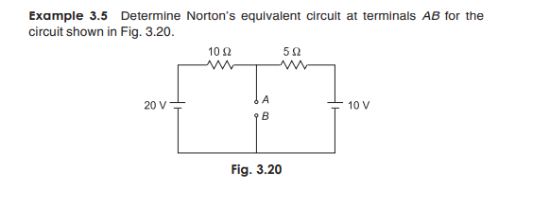

Slide 12
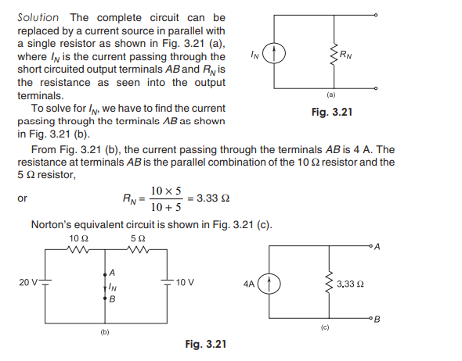

Slide 13
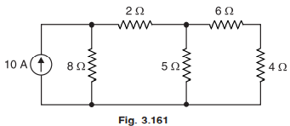
Example 3.63. Using Norton’s theorem, calculate the current in the 5 Ω resistor in the circuit shown in Fig. 3.161

Slide 14

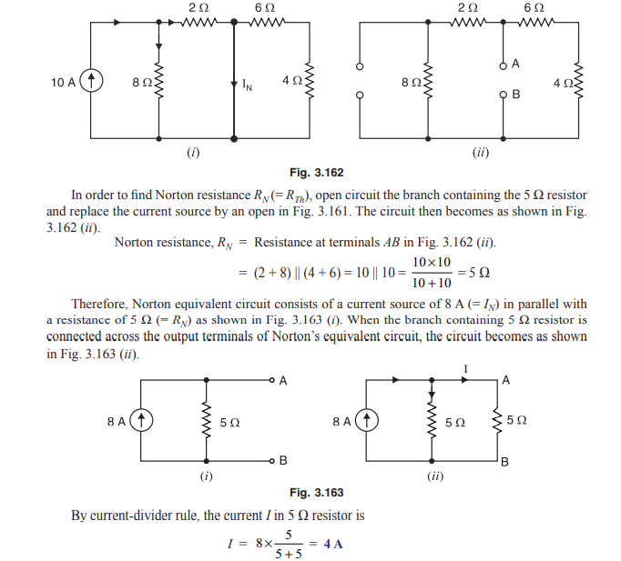

Slide 15
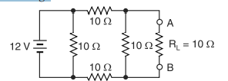
Find Norton equivalent circuit for Fig. 3.164 (i). Also solve for load current and load voltage

